Slide 1

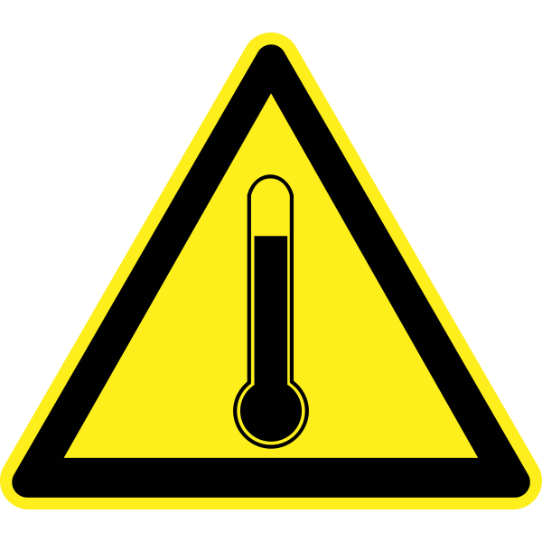

Tomorrow’s Temperature Prediction

Slide 2

INTRODUCTION
Weather prediction has long been a critical aspect of our daily lives, influencing activities ranging from agriculture and transportation to disaster preparedness. This project addresses the need for an efficient and accurate method of predicting tomorrow's temperature by utilizing historical weather data. The integration of predictive modeling into weather forecasting can significantly enhance our ability to plan and adapt to changing climatic conditions.
This project aims to develop a predictive model for forecasting tomorrow's temperature based on historical weather data. Leveraging machine learning algorithms and statistical analysis, the model seeks to provide accurate and reliable predictions to enhance short-term weather forecasting. The integration of advanced data analytics techniques will contribute to improved decision-making processes for various industries and individuals dependent on precise weather information

Slide 3
PROBLEM STATEMENT
In the domain of meteorology and daily life planning, accurate and timely temperature predictions play a pivotal role. Despite advancements in weather forecasting, there exists a need for a reliable and efficient model capable of predicting tomorrow's temperature with precision
Current weather prediction systems often face challenges in providing localized and accurate forecasts for short-term periods
This project aims to address this gap by developing and implementing a predictive model that leverages historical weather data to forecast temperatures for the upcoming day
The goal is to enhance the reliability of short-term weather predictions, enabling individuals and various industries to make informed decisions based on trustworthy temperature forecasts.

Slide 4
DATA COLLECTION AND FEATURES
To predict tomorrow’s temperature, relevant data needs to be collected. Here are some key aspects of data collection and the features that can be considered:
I got my dataset from NOAA https://www.noaa.gov/
Weather Informations:
TMIN: Minimum Temperature of each day
TMAX: Maximum Temperature of each day
TAVG: Average Temperature of each day
STATION: Weather station where data are collected and measured
DATE: Date of taken weather records

Slide 5
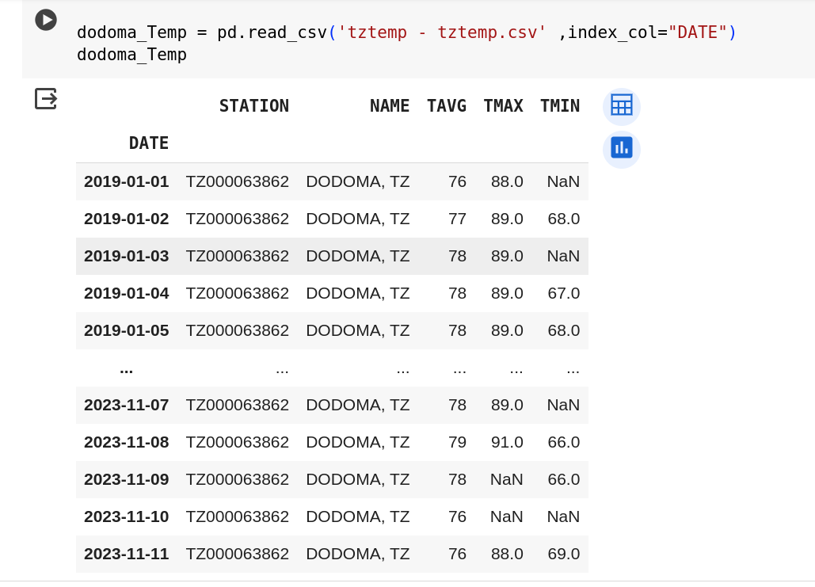
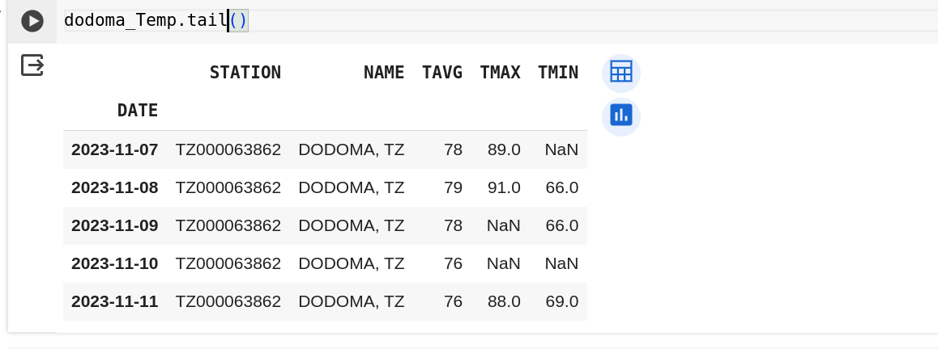
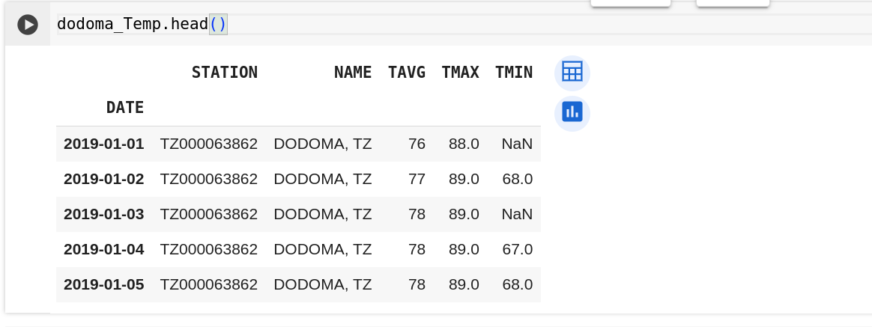
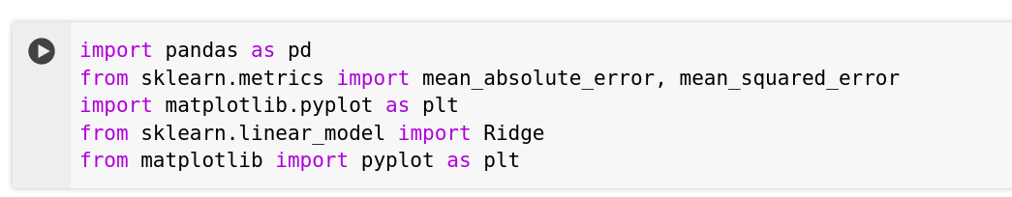
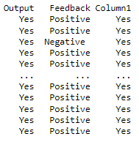
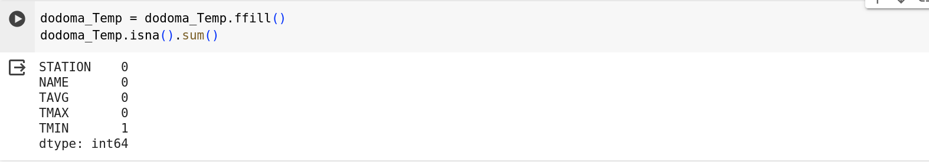
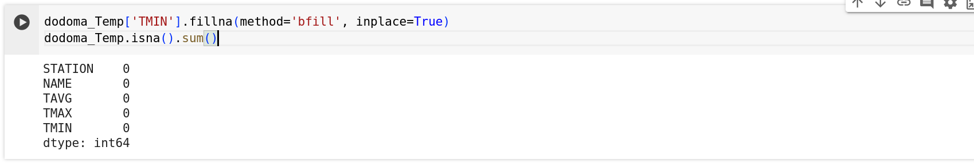
DATA PREPROCESSING
Data preprocessing is a crucial step in preparing the collected data for training a predictive model. Here are the common steps:
1. Importing libraries and data 2. Output of data
Handling Missing Values : Imputing missing values using techniques
like mean, median, mode, or predictive modeling.
Data Analysis : filling missing data in the dataset,
the next step can indeed be the analysis of data using matlibplot library.
Analyzing the Average Temperature from my dataset
Plot line graphs using a suitable visualization library
like Matplotlib.

Slide 6
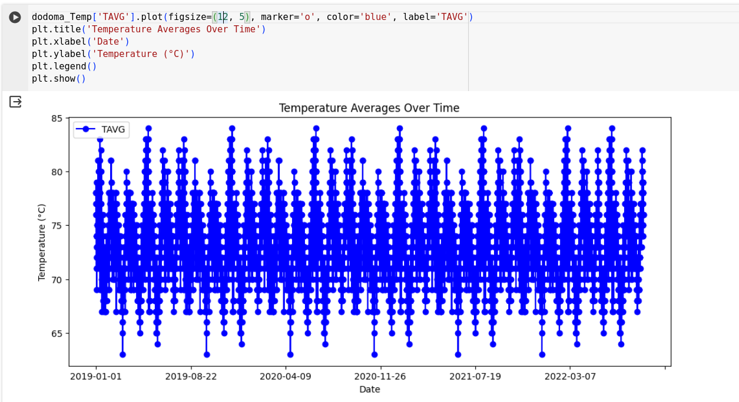
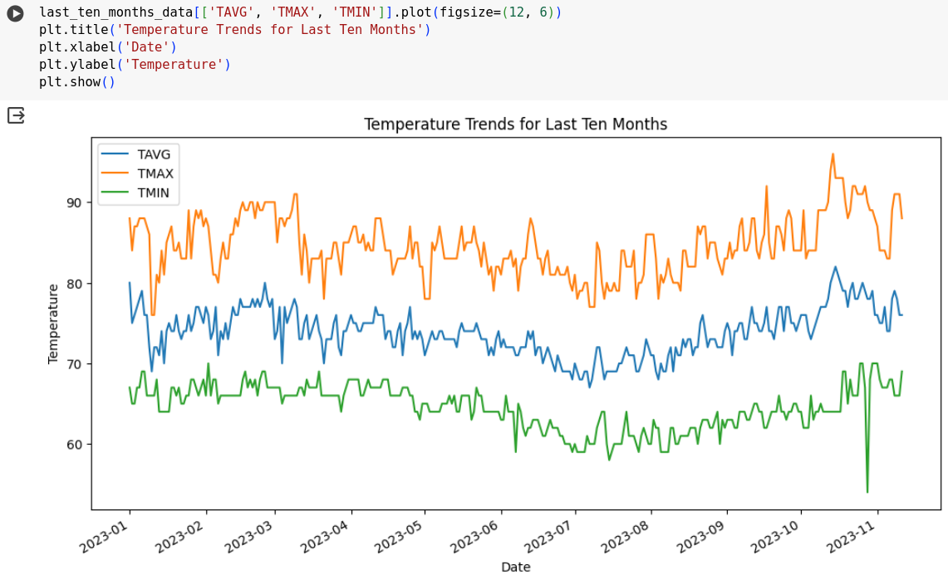
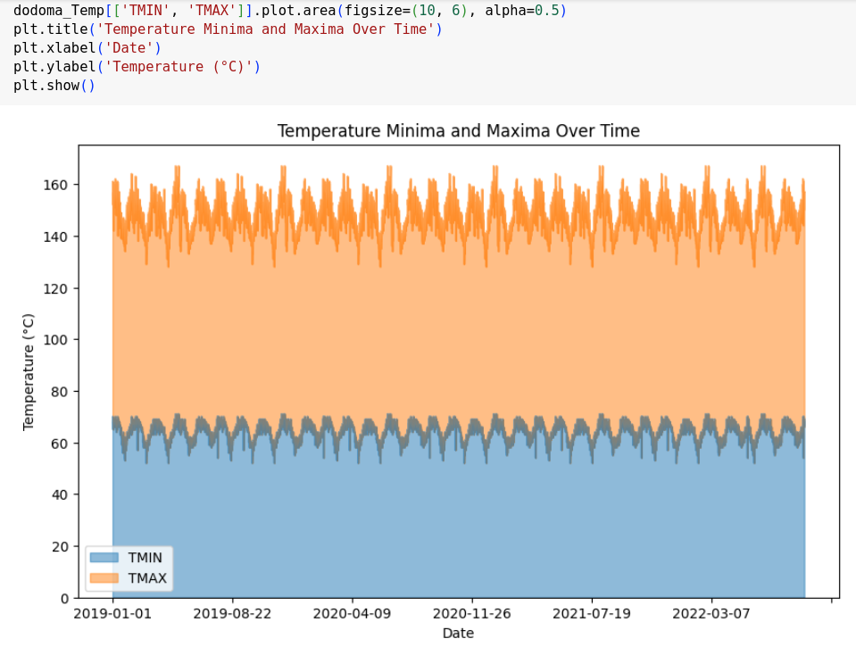
4.Analysis of TAVG
Box Plot for Temperature Statistics (TAVG, TMIN, TMAX)
5.Analysis of minimum and maximum Temperature

Slide 7
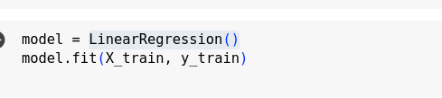
The algorithm used for creating Model is LinearRegression.

Slide 8
For example, if test_size is set to 0.10 (or 10%), it means that 10% of the data will be reserved for testing, while the remaining 90% will be used for training the LinearRegression.
The test data is used to evaluate how well the trained model generalizes to unseen examples.
The r2_score() function calculates the accuracy of the model by comparing the predicted labels with the actual labels from the test data.
The returned r2_score value represents the accuracy of the model on the test data, typically ranging from 0 to 1, where 1 represents a perfect prediction.
By printing the r2_score, we can see how well the trained LinearRegression model performs on the provided test data.
So the accuracy is 0.753

Slide 9
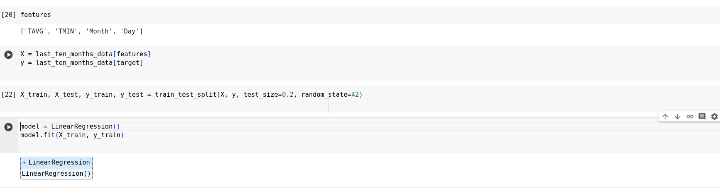
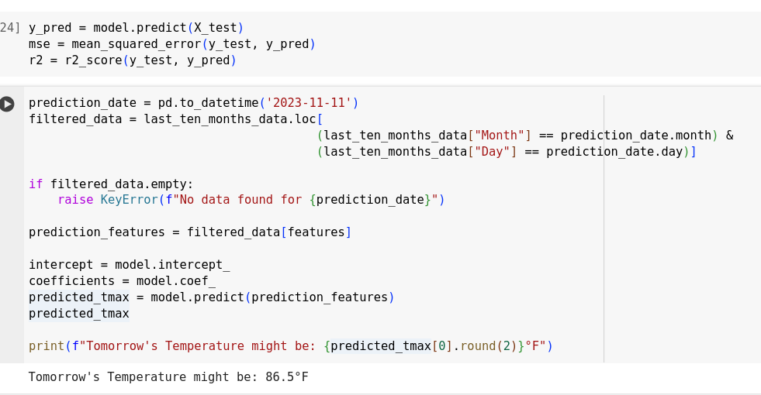
training a model
Result of the Model

Slide 10
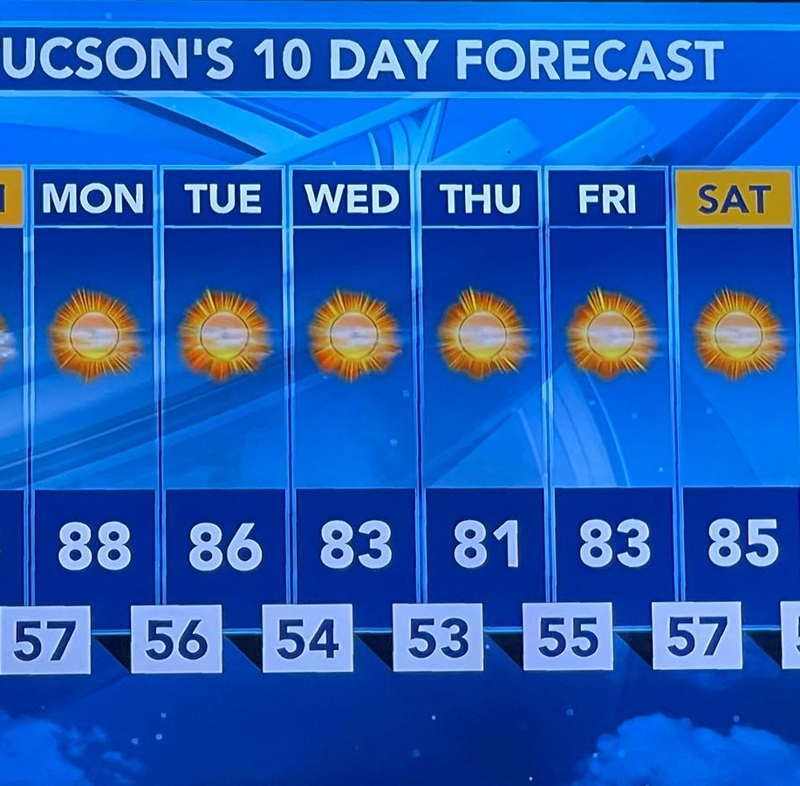
CONCLUSION
Achieved Goal: Successfully built a model to predict tomorrow's temperature accurately using historical weather data and advanced techniques.
Overcame Challenges: Dealt with challenges in preparing data and choosing the right model through iterative improvements, ensuring the model's strength.
Gainful Insights: Analyzed temperature trends through plots and comparisons, gaining valuable insights into the model's performance.
Useful for Users: The model is a practical resource for various users, aiding decision-making by providing reliable short-term weather forecasts.
Continuous Improvement: Future plans include expanding data, adding features, and exploring advanced methods for even better predictions. Regular feedback will be crucial.
Successful Solution: In conclusion, the project is a successful step forward in weather forecasting, offering a reliable and practical solution for accurate short-term temperature predictions.

Slide 11



